Slide 1
BRONCHIECTASIS
Dr. K.V.CHALAPATHI RAO
PROFESSOR
DEPARTMENT OF GENERAL MEDICINE

Slide 2
OUTLINE
Definition Etiopathogenesis Clinical features
Theories of bronchiectasis Site of bronchiectasis
Classification Prevalence Investigations Treatment Complications

Slide 3
ETIOPATHOGENESIS
DEVELOPMENTAL DEFECTS:
Structural: Pulmonary agenesis, sequestrated segment, tracheobronchomegaly, Bronchomalacia
Biochemical: alpha 1 antitrypsin deficiency
PRIMARY INFECTIVE INSULT:
Bronchitis/ Bronchiolitis, pneumonia, tuberculosis

Slide 4
PRIMARY IMPAIRMENT OF MUCOUS CLEARANCE:
Genetic, biochemical: Cystic fibrosis
Genetic, ultrastructural: Primary ciliary dyskinesia
INFECTION, SECONDARY TO BRONCHIAL OBSTRUCTION:
Intraluminal: slow growing tumour, aspirated foreign body
Extraluminal: lymphadenopathy

Slide 5
IMMUNODEFICIENCY SYNDROMES:
Congenital and acquired: common variable immunodeficiency, selective Ig deficiency, functional immune deficiency, secondary hypogammaglobulinemia, HIV infection
Hyperimmune response: Allergic bronchopulmonary aspergillosis
MISCELLANEOUS INFLAMMATION:
Autoimmune disease: IBD, Celiac disease, SLE, rheumatoid disease, cryptogenic
fibrosing alveolitis, primary biliary cirrhosis, thyroiditis, pernicious anaemia
Inhalational / aspiration injury: Toxic fumes/ Gastric contents

Slide 6
THEORIES OF BRONCHIECTASIS
Atelectasis theory
Pressure of secretions theory
Traction theory

Slide 7
ATELECTASIS THEORY
Aspiration of viscid material into peripheral parts of the bronchial tree may result in atelectasis and dilatation of the bronchi in the collapsed area, which is compensatory , in turn reduces lung volume and increases intrapulmonary negative pressure, these in turn dilates any bronchi proximal to the block, as these remain in communication with the atmosphere.

Slide 8
PRESSURE OF SECRETIONS THEORY
Following mucous plug obstruction of a bronchi, secretions distal to the obstruction accumulate and mechanically distend the bronchi beyond the block

Slide 9
TRACTION THEORY
Bronchial dilatation occurs secondary to fibrosis of lung parenchyma, the resulting scar tissue requiring high inflation pressures on inspiration to overcome abnormally high retractive forces

Slide 10
SITE OF INVOLVEMENT
Lower lobes > middle and lingular lobe > upper lobes
Left lower lobe is the most common site.

Slide 11
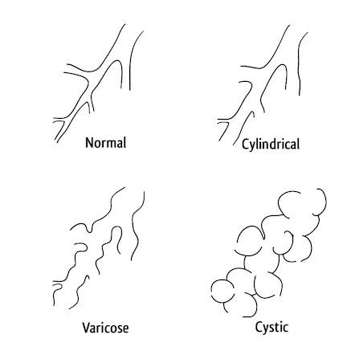

Slide 12
REID’S CLASSIFICATION
CYLINDRICAL BRONCHIECTASIS:
Tram track lines in longitudinal section & signet ring sign in case of horizontal section
VARICOSE BRONCHIECTASIS:
Irregular or beaded appearance with alternating dilatation and constriction
CYSTIC BRONCHIECTASIS:
Large cystic spaces and honeycomb appearance
Contrasts with blebs of emphysema

Slide 13
WHITEWELLS CLASSIFICATION
FOLLICULAR BRONCHIECTASIS
Presence of numerous lymphoid follicles, situated in thickened cylindrically dilated
bronchial walls
SACCULAR BRONCHIECTASIS
Presence of macroscopically visible thin walled, saccular bronchial dilatations
ATELECTATIC BRONCHIECTASIS
Associated with pulmonary collapse, predominantly right sided

Slide 14
COLONISERS
Haemophilus influenza
Streptococcus pneumoniae
Staphylococcus aureus
Pseudomonas aeruginosa

Slide 15
CLINICAL FEATURES
SYMPTOMS:
Persistent productive cough with copious mucopurulent sputum
Hemoptysis
Dyspnea
General tiredness, malaise
SIGNS:
Persistent early and mid inspiratory coarse crackles, not shifted on coughing

Slide 16
INVESTIGATIONS
Complete haemogram
Serum total IgE and assessment of sensitization to A.fumigatus
Serum IgG, IgA & IgM
Test for cystic fibrosis, primary ciliary dyskinesia in patients with supporting clinical features
Sputum culture

Slide 17
Consider testing for RF, anti CCP, ANA & ANCA in patients with co-existing clinical
features of arthritis, CTD and or systemic vasculitis
Testing for A1AT deficiency in patients with co-existing basal pan acinar
emphysema
Bronchoscopy in patients with localized disease to r/o endobronchial lesion/foreign body as the cause of bronchiectasis
Serum protein electrophoresis in patients with raised Igs

Slide 18
RADIOLOGICAL FEATURES
PLAIN CHEST RADIOGRAPH:
Sensitivity 87.8% , Specificity 74.4%
Ring shadows – produced by dilated bronchi seen end-on-----honeycomb lung, cystic lung
Parallel lines – produced by dilated bronchi viewed side-on-----tram lines
Solid tubular opacities – finger in glove appearance
Features of PHTN – prominent proximal pulmonary artery trunks with cardiac
enlargement – extensive disease

Slide 19
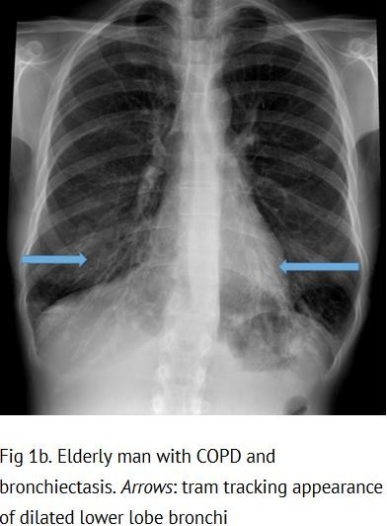
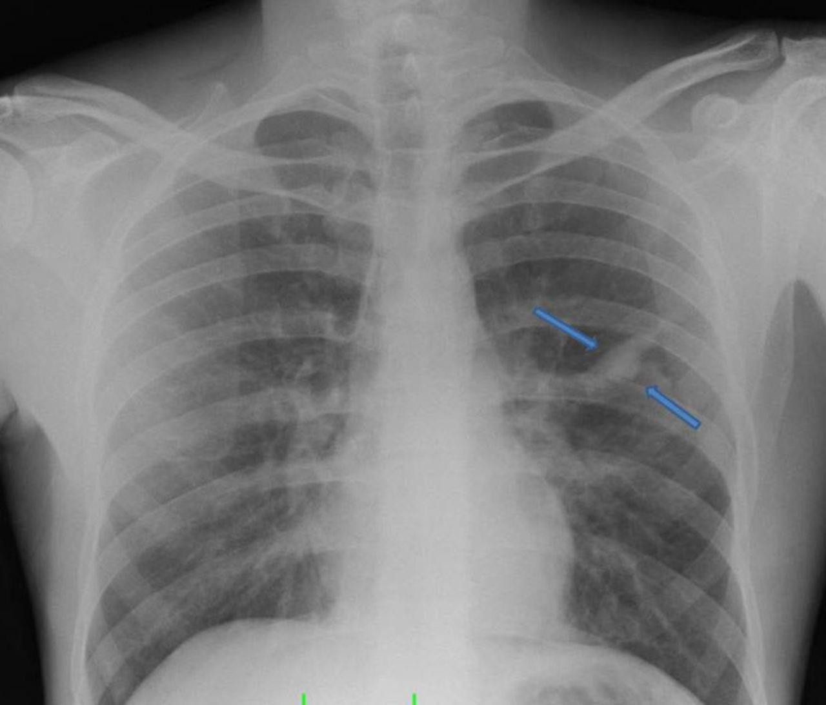

Slide 20
BRONCHOGRAPHY:
Instillation of liquid contrast medium into the tracheobronchial tree
Aqueous or oily propyliodine or iotrolan was commonly used
Affected parts of the lungs showed areas of bronchial dilatation
Failure of bronchi to taper
Diminished number of bronchial side branches
Luminal filling defects due to bronchial secretions

Slide 21
COMPUTED TOMOGRAPHY:
HRCT is the investigation of choice
Sensitivity – 82 to 97%
False positive & negative rates of 1 &2%
1-2mm cuts at 10mm intervals, reducing to 5mm intervals at areas of particular interest
The two main features are bronchial dilatation and bronchial wall thickening
A bronchus is said to be dilated if its internal diameter is greater than that of the accompanying pulmonary artery (broncho arterial ratio>1)
Bronchial wall thickening is said to be present if the thickness of the wall is atleast equal to the diameter of the adjacent pulmonary artery branch

Slide 22
DIRECT SIGNS
INDIRECT SIGNS
Bronchial dilatation
Signet ring sign
Tram tracts sign
Varicose appearance
Air filled cysts
Lack of tapering >2cm distal to bifurcation
Visibility of the peripheral airways
thickening
Bronchial wall thickening
Fluid or mucus filled bronchi
Mosaic perfusion
Centrilobular nodules
Atelectasis / consolidation
Air trapping on expiratory scan

Slide 23
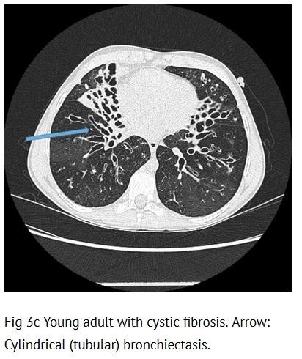
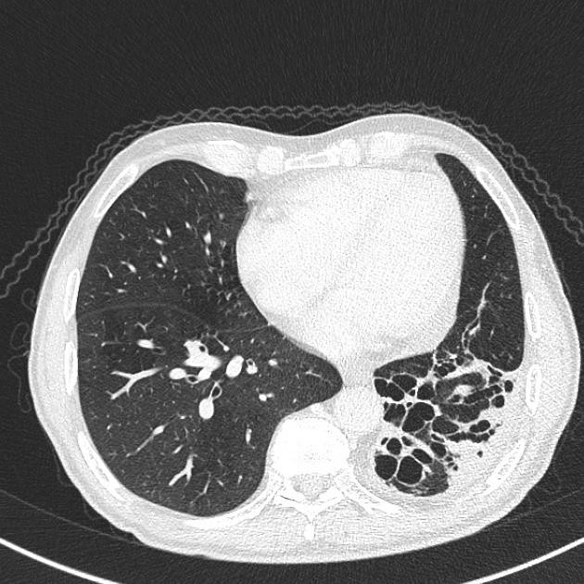
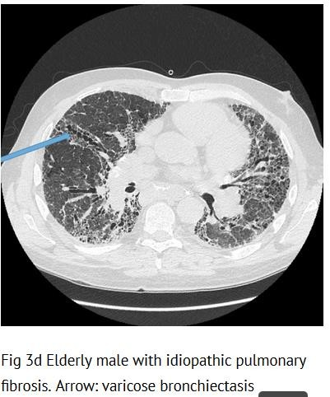

Slide 24
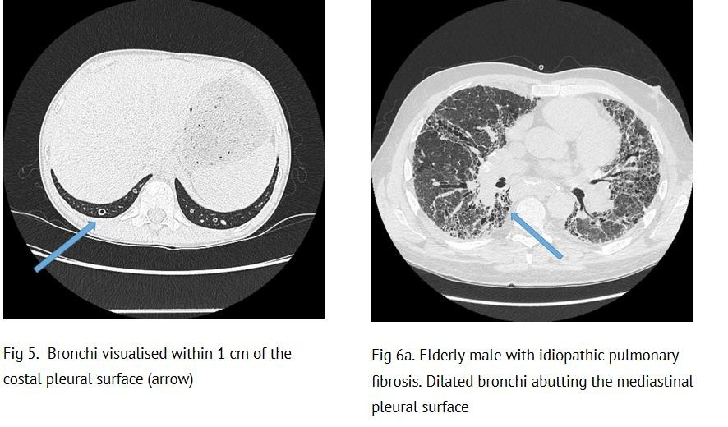

Slide 25
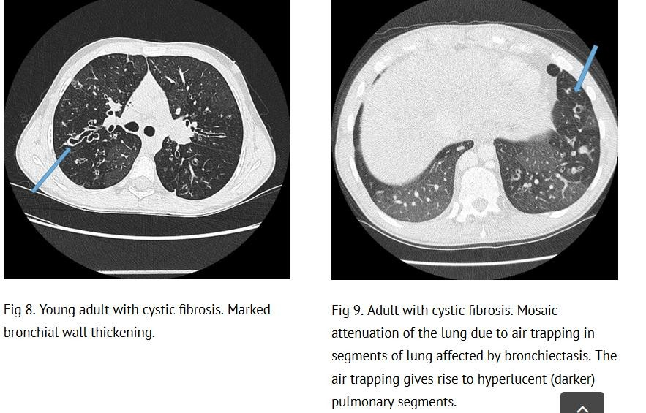

Slide 26
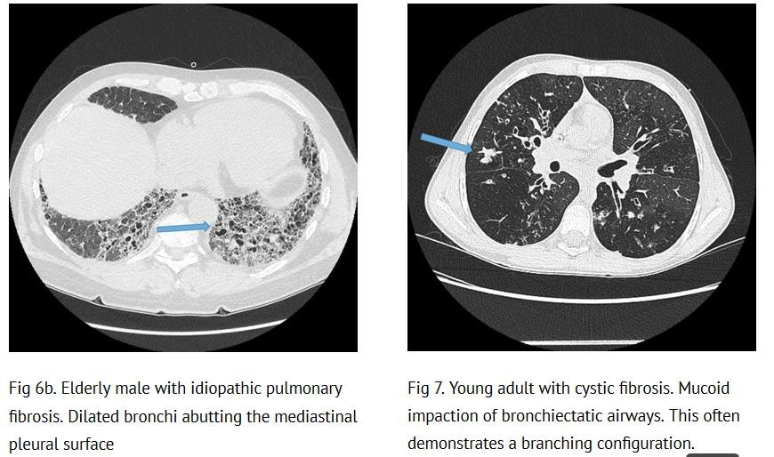

Slide 27
SEVERITY SCORING
To predict the risk of future mortality, morbidity, hospital admissions & exacerbations in patients with bronchiectasis
The two scaling systems are BSI & FACED score FACED SCORE includes
F – FEV1
A- Age
C- P.aeruginosa Colonisation
E- Extent of bronchiectasis
D- Dyspnea
Each variable is scored as 0,1 or 2
The 5 year mortality in mild(0-2), moderate(3-4) and severe(5-7) disease is 4%, 25% & 56%

Slide 28
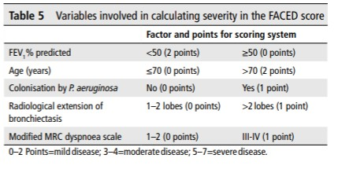

Slide 29
BSI score:
Includes age, BMI, FEV1, Previous hospitalization, exacerbation frequency, colonization status, radiological appearances
The score was designed to predict future exacerbations, hospitalisations, health status and death over 4 years
Score of 0-4 (mild) – 0-2.8% mortality & 0-3.4% hospitalization rate over 1 year
0-5.3% mortality & 0-9.2% hospitalization rate over 4 years
Score of 5-8 (moderate) – 0.8-4.8% mortality & 1-7.2% hospitalization at 1 year
4-11.3% mortality & 9.9-19.4% hospitalization at 4 yrs
Score >9 (severe) – 7.6-10.5% mortality & 16.7-52.6% hospitalization at 4yrs
9.9-29.2% mortality & 41.2-80.4% hospitalization rates at 4 yrs

Slide 30
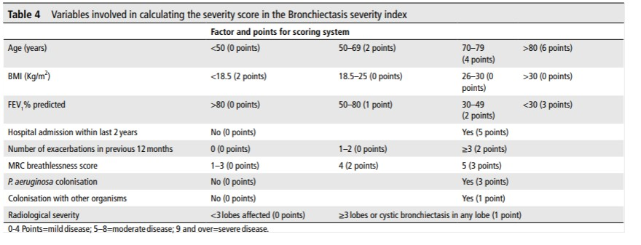

Slide 31
TREATMENT
MEDICAL TREATMENT:
Antimicrobial chemotherapy AIRWAY CLEARANCE TECHNIQUE:
Active cycle of breathing techniques or oscillating positive expiratory pressure should be offered along with gravity assisted positioning to enhance the effectiveness of an airway clearance
Postural drainage is the use of gravity assisted positioning to drain areas of the lung
Basal bronchi – leaning forward over the edge of a low bed using the arms as a support against the floor
Middle lobe or lingular bronchi – patient lying supine with the foot of the bed elevated and the affected side lifted off the bed by pillows

Slide 32
Manual techniques like PD, percussion & coughing, PD and huffing cleared the most secretions when performed for two 20min sessions in succession
Inspiratory muscle training
High frequency chest wall oscillation
Intrapulmonary percussive ventilation
Intermittent positive pressure breathing
Regular physical exercise helps to promote airway clearance

Slide 33
MUCOACTIVES:
Expectorants (aid and/or induce cough), Mucolytics (thin mucus), Mucokinetics (facilitate cough transportability) and Mucoregulators (suppress mechanisms underlying chronic mucus hypersecretion, such as glucocorticoids)
Recombinant human DNase breaks down the DNA released at the site of infection by the neutrophils. DNA causes the sputum to become thick and tenacious and therefore inhaled DNase makes makes the sputum less viscious and easier to expectorate
However, recombinant human DNase increases exacerbation frequency
Isotonic & hypertonic saline improved cough related & health related quality of life
Use of humidification prior to airway clearance improves sputum yield and radiolabeled clearance
Oral mucolytics can improve sputum expectoration
Consider bronchodilator therapy prior to inhaled mucoactive treatment

Slide 34
Do not routinely offer inhaled corticosteroids, oral corticosteroids, PDE4 inhibitors, methyl xanthines, LTR antagonists for bronchiectasis treatment
LONG TERM ANTIBIOTICS:
Consider long term antibiotics in patients with bronchiectasis who experience three or more exacerbations per year
P.aeruginosa colonized patients:
Use inhaled colistin
Consider inhaled Gentamycin as a second line alternative to colistin
Consider azithromycin/erythromycin as an alternative to inhaled antibiotics
Consider azithromycin/erythromycin as an additive treatment to inhaled
antibiotics, for patients who have a high exacerbation frequency

Slide 35
Non- P.aeruginosa colonized patients:
Use azithromycin or erythromycin
Consider inhaled gentamicin as a second line alternative
Consider doxycycline as an alternative in patients in whom macrolides are ineffective/intolerant
Review patients on long term antibiotics 6 monthly with assessment of efficacy,
toxicity and continuing need. Monitor sputum culture and sensitivity regularly
Consider cyclical IV antibiotics in patients with repeated infections(>5/year)

Slide 36
ERADICATION THERAPY:
First line treatment: Ciprofloxacin 500-750mg BD for 2 weeks
Second line treatment: IV anti-pseudomonal beta lactam +/- IV aminoglycoside for 2 weeks, followed by a 3 month course of nebulized colistin, gentamicin or tobramycin

Slide 37
PULMONARY REHABILITATION:
Pulmonary rehabilitation increases exercise capacity and can improve quality of life in individuals with bronchiectasis, reduces the frequency of exacerbation over a 12 month period and can increase the time to first exacerbation.
6MWT & ISWT are reliable and responsive outcome measures for use in bronchiectasis to evaluate exercise capacity pre and post pulmonary rehabilitation
Pulmonary rehabilitation should be offered to individuals who are functionally
limited by shortness of breath (MMRC>1)

Slide 38
SURGICAL TREATMENT:
Indications for surgical resection:
Persistent symptoms despite up to a year of comprehensive medical treatment
Exacerbations that are either severe or frequent and interfere with social or professional life
Recurrent refractory or massive hemoptysis
Post obstruction bronchiectasis
Localized severely damaged lobe/segment
Surgery may be helpful in bronchiectasis in reducing exacerbations or treating hemoptysis
Consider nutritional support and pre-operative pulmonary rehabilitation before surgical referral

Slide 39
LUNG TRANSPLANTATION:
Patients aged 65 years or less
FEV1<30% with significant clinical instability
Rapid progressive respiratory deterioration despite optimal medical management
Consider earlier transplant in patients with poor lung function with added risk factors such as hemoptysis, severe secondary pulmonary hypertension, ICU admissions or respiratory failure

Slide 40
INFLUENZA AND PNEUMOCOCCAL VACCINATION:
Offer annual influenza and polysaccharide pneumococcal vaccination to all patients with bronchiectasis
Consider influenza vaccination in household contacts of patients with immune
deficiency and bronchiectasis to reduce the risks of secondary transmission
Consider use of 13 valent protein conjugate pneumococcal vaccine in patients with bronchiectasis who do not have an appropriate serological response to standard polysaccharide vaccine.

Slide 41
TREATMENT OF RESPIRATORY FAILURE:
NIV with humidification may lead to a reduction in hospitalization days in patients with bronchiectasis and hypercapnic respiratory failure
Consider LTOT for patients with bronchiectasis and respiratory failure

Slide 42
BRONCHIECTASIS & ABPA
Offer oral corticosteroids at an initial dose of 0.5mg/kg/day for 2 weeks to patients with active ABPA
Consider Itraconazole as a steroid sparing agent for patients dependent on
corticosteroids where difficulty in weaning is experienced
Total IgE is the most sensitive marker for monitoring treatment response.

Slide 43
BRONCHIECTASIS & CO-MORBIDITIES
Consider a trial of inhaled or oral corticosteroids in patients with Bronchiectasis and IBD
Ensure optimal control of asthma and allergies in patients with asthma &
bronchiectasis
Monitor patients with co-morbid COPD and bronchiectasis as they are at higher
risk of death
Patients with bronchiectasis who require DMARDs or biologics for RA should be referred to a chest physician for further assessment before treatment is started.

Slide 44
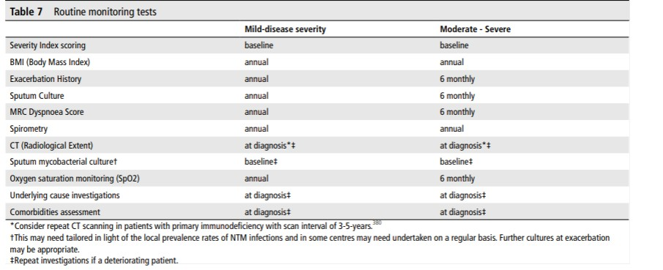
TESTSTO MONITOR:

Slide 45
COMPLICATIONS
Hemoptysis
Sinusitis
Brain abscess
Amyloidosis
Disseminated aspergillosis
Systemic hypersensitivity vasculitis
Lung cancer
Operative complications – hemorrhage, atelectasis, pneumonia, empyema,
bronchopleural fistula and pneumothorax.

Slide 46
THANK YOU

